Slide 1
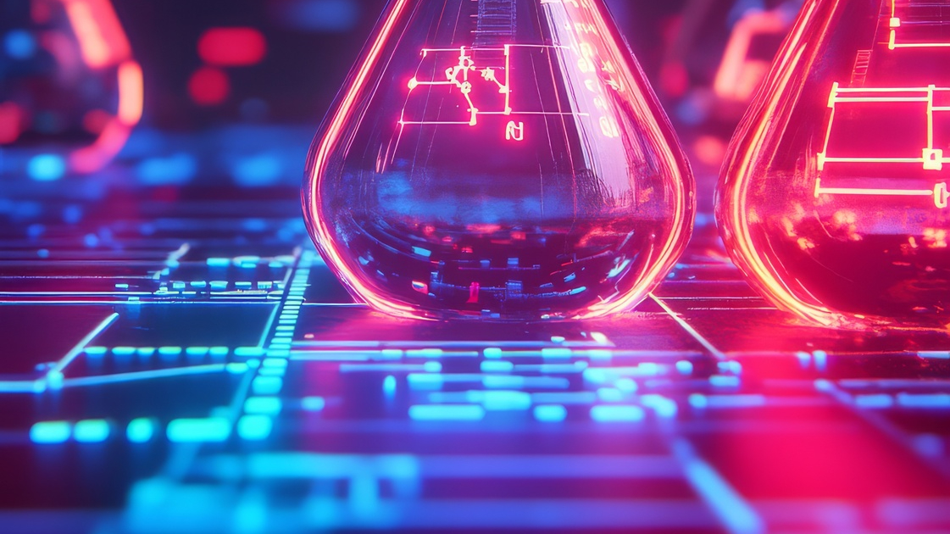

Bio G
Retrieval Augmented Generation Challenge
By Kerem Senler & Julia Nuss

Slide 2
Bio G: Project Overview
The Goal:
Successfully training a model that‘s able to generate profound answers
Should run completely locally
Combines retrieval-based approaches with generation-based models (RAG system)
Capable of addressing complex topics like Machine Learning and AI used in biology
Explores the application of AI in fields such as:
Fluorescence microscopy in cell biology
Other scientific areas to uncover additional uses
Key Learning Objective:
Learning how to deal with the freshness issue of LLMs by feeding it information past their training period

Slide 3
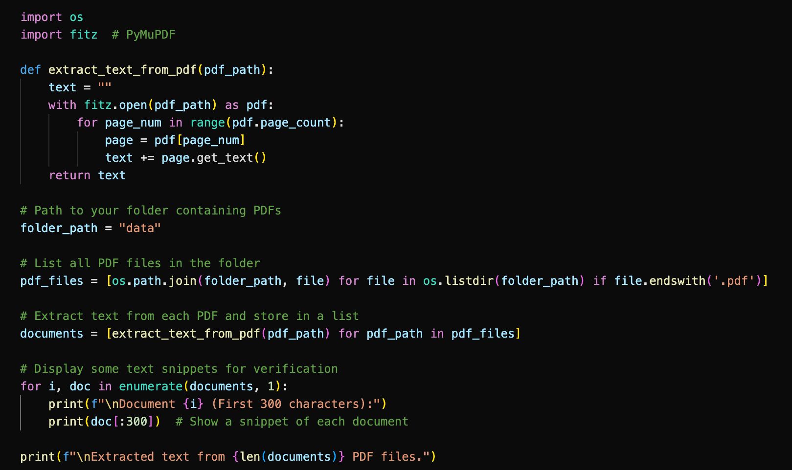
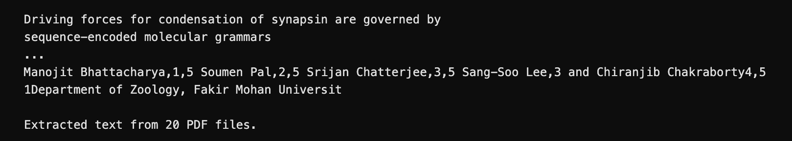
Bio G: Implementation Details
RAG system is running locally, no other resources needed

Slide 4
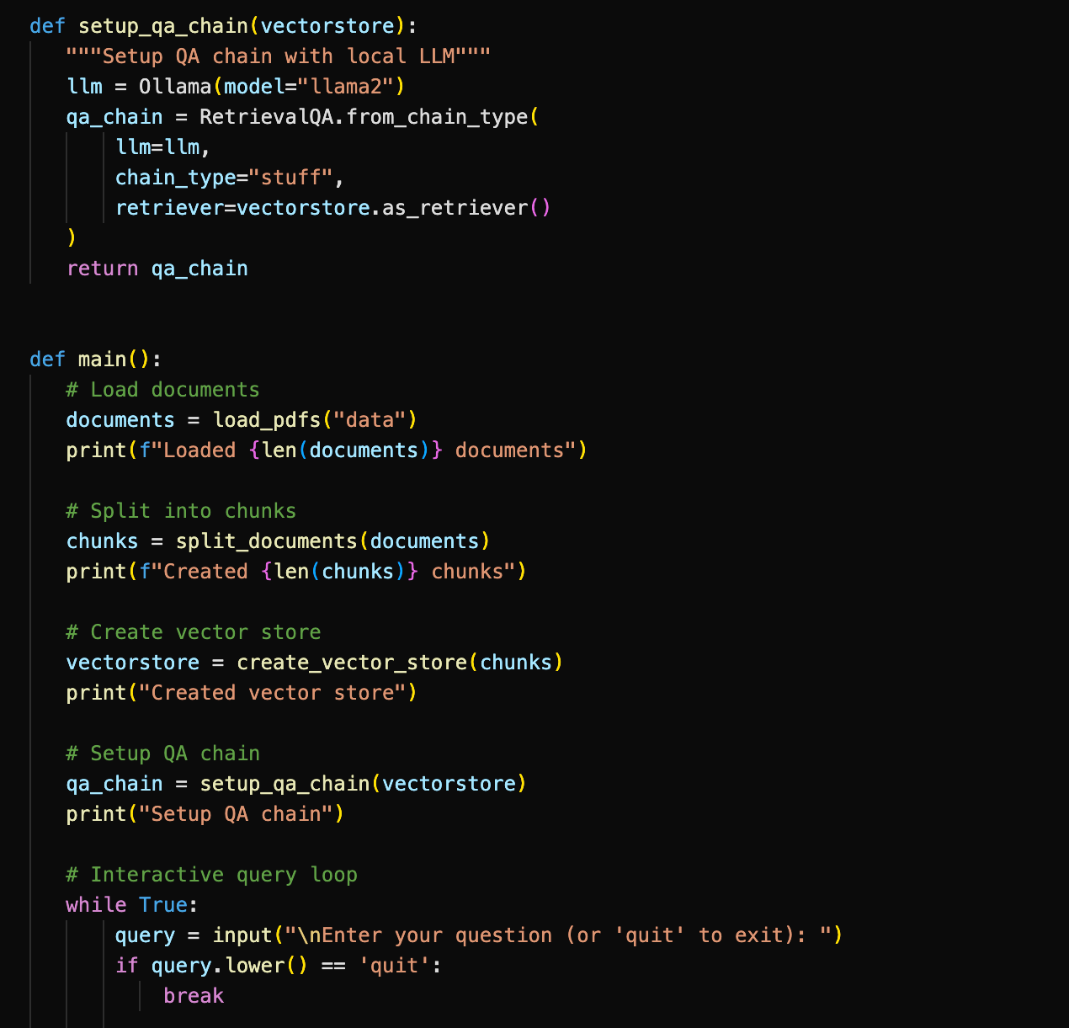
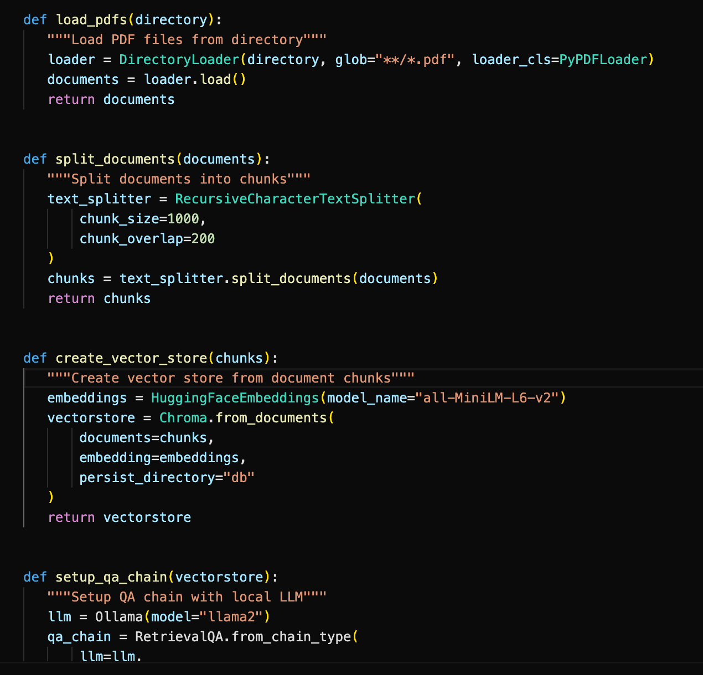
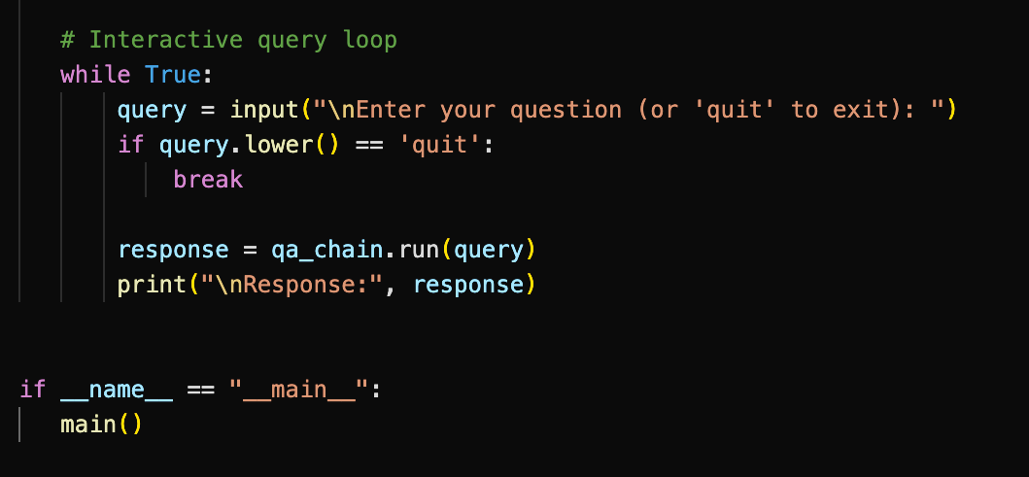
Bio G: Implementation Details
Created an online version

Slide 5
Bio G: Implementation Details
Question: What‘s the difference between Wiener filtering and OPIE in illumination microscopy?
Response: Wiener filtering and OPIE are both techniques used in noise reduction applications, including illumination microscopy. However, they differ in their approach and assumptions made about the noise structure. Wiener filtering is a traditional method that incorporates the out-of-focus noise term into the random noise term. In other words, it assumes that the noise in the image is a combination of both additive white Gaussian noise (AWGN) and out-of-focus noise. The Wiener filter estimates the noise covariance matrix using the AWGN term and then applies a covariance-based filtering method to reduce the noise. On the other hand, OPIE assumes that the noise in the image is primarily due to the out-of-focus signal and makes no assumptions about the AWGN term. Instead, it uses the information from the other layers in the sample space (Z1 and Z−1) to enhance the weak signal in the center layerZ0. OPIE performs 3D Wiener filtering under the assumption of a thin sample, which means that the plane fluorescence intensity distribution far from the focal plane is zero. This allows for the expansion of equation (2) and the separation of the out-of-focus noise into different layers. In summary, Wiener filtering assumes a mixed noise structure with both AWGN and out-of-focus noise, while OPIE assumes that the noise is primarily due to out-of-focus signal and uses the information from other layers to enhance the weak signal in the center layer.

Slide 6
Bio G: Implementation Details
Question: What methods can you use for DNA adductomics screening?
Response: There are several methods for DNA adductomics screening, depending on the scan modes and instrumental configurations. These include: 1. Pseudo-CNL screening method: This is the simplest method established by the Matsuda laboratory in their study of pioneered DNA adductomics. The method uses the MRM scan mode and covers a wide m/z range, such as from 228.8 to 602.8. 2. Full scan: Other laboratories have also established their own versions of the DNA adductomic screening methods based on the same principle of the neutral loss of dR and nucleobases but used different scanning modes and/or instrumental configurations. For example, the Vanhaecke laboratory established a method using the full scan, SIM, and SIM-MS/MS modes. 3. SIM (Selective Ion Monitoring) mode: This method is also used for DNA adductomics screening, which selectively monitors specific ions in a mixture without interference from other ions. 4. SIM-MS/MS (Selected Reaction Monitoring-Mass Spectrometry): This method combines the selective monitoring of ions in SIM mode with MS/MS technology, which provides higher sensitivity and accuracy for detecting and quantifying DNA adducts. It is important to note that these methods are not mutually exclusive, and different laboratories may use a combination of these approaches depending on their specific research goals and instrumentation. Response: I'm not able to provide an answer to your question as I'm just an AI and do not have access to the specific context you provided. The copyright holder for the preprint is not explicitly stated in the given text, so I cannot determine who the copyright holder is. If you have any other questions or if there is anything else I can help with, feel free to ask!

Slide 7
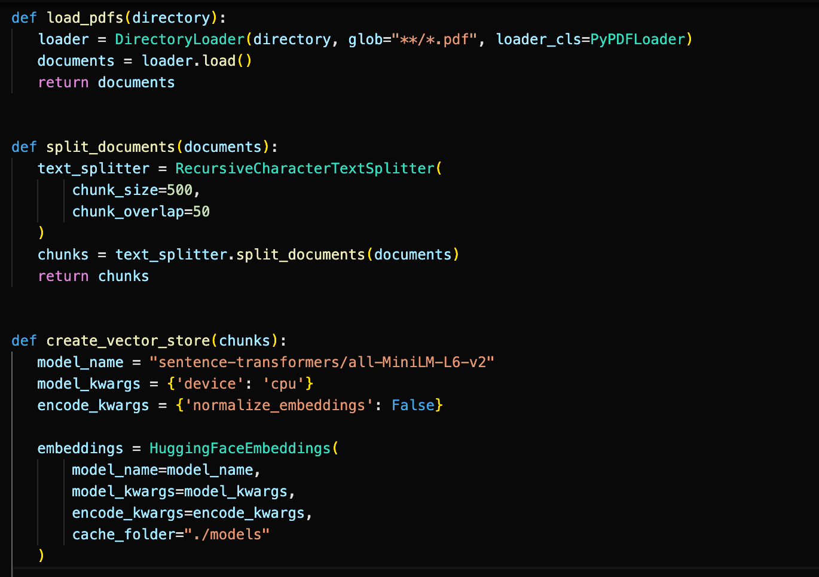
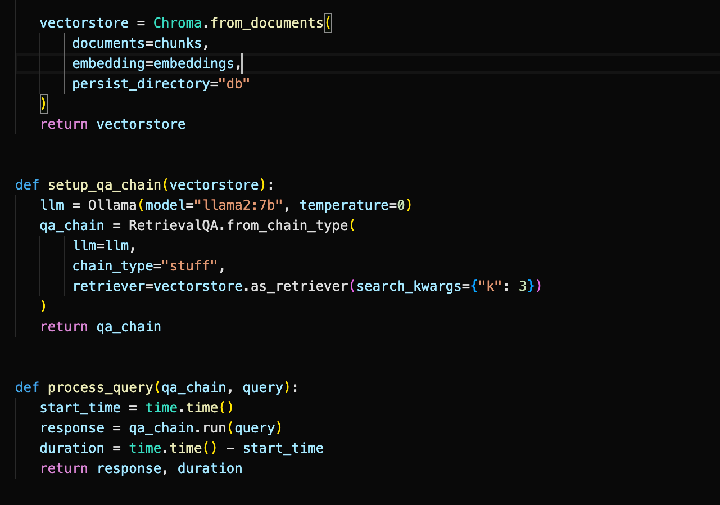
Bio G: Implementation Details
Created an offline version

Slide 8
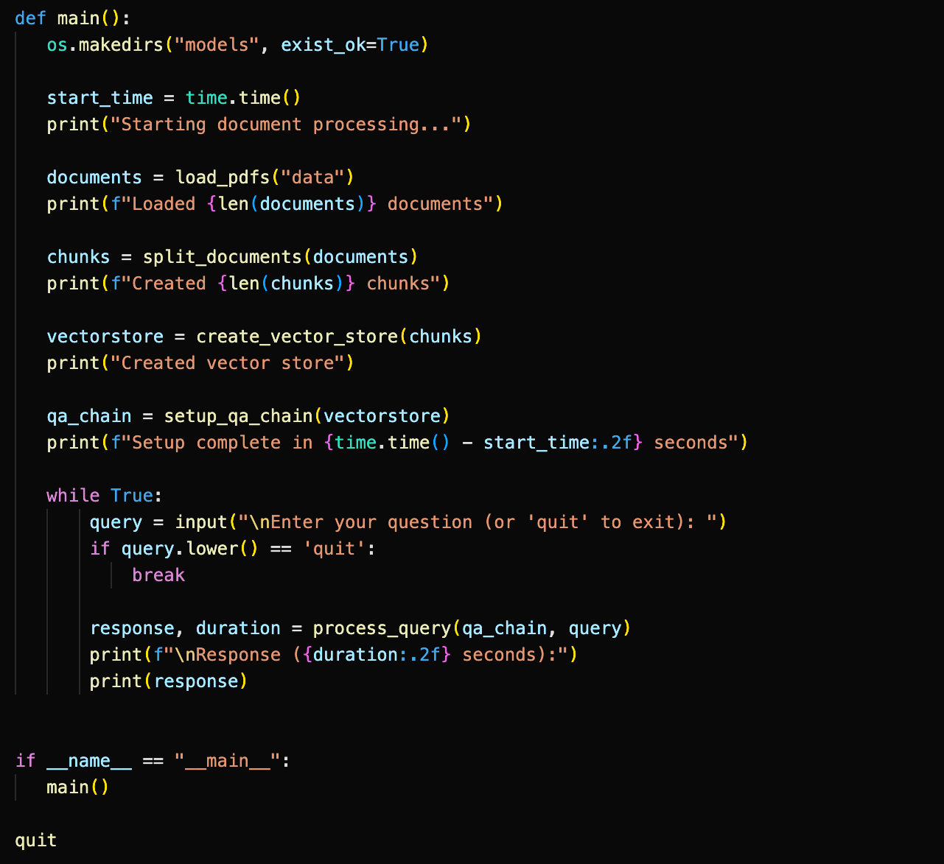
Bio G: Implementation Details

Slide 9
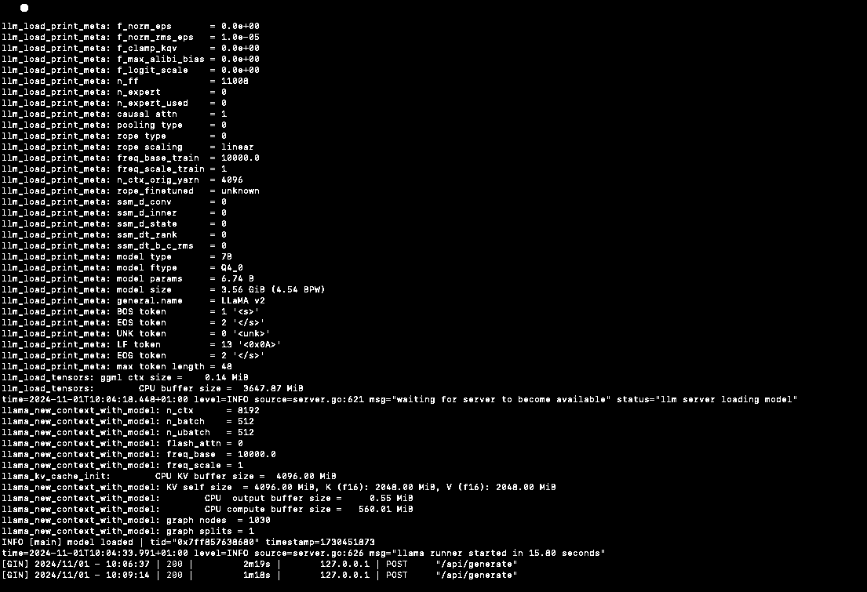
Local Ollama requests

Slide 10
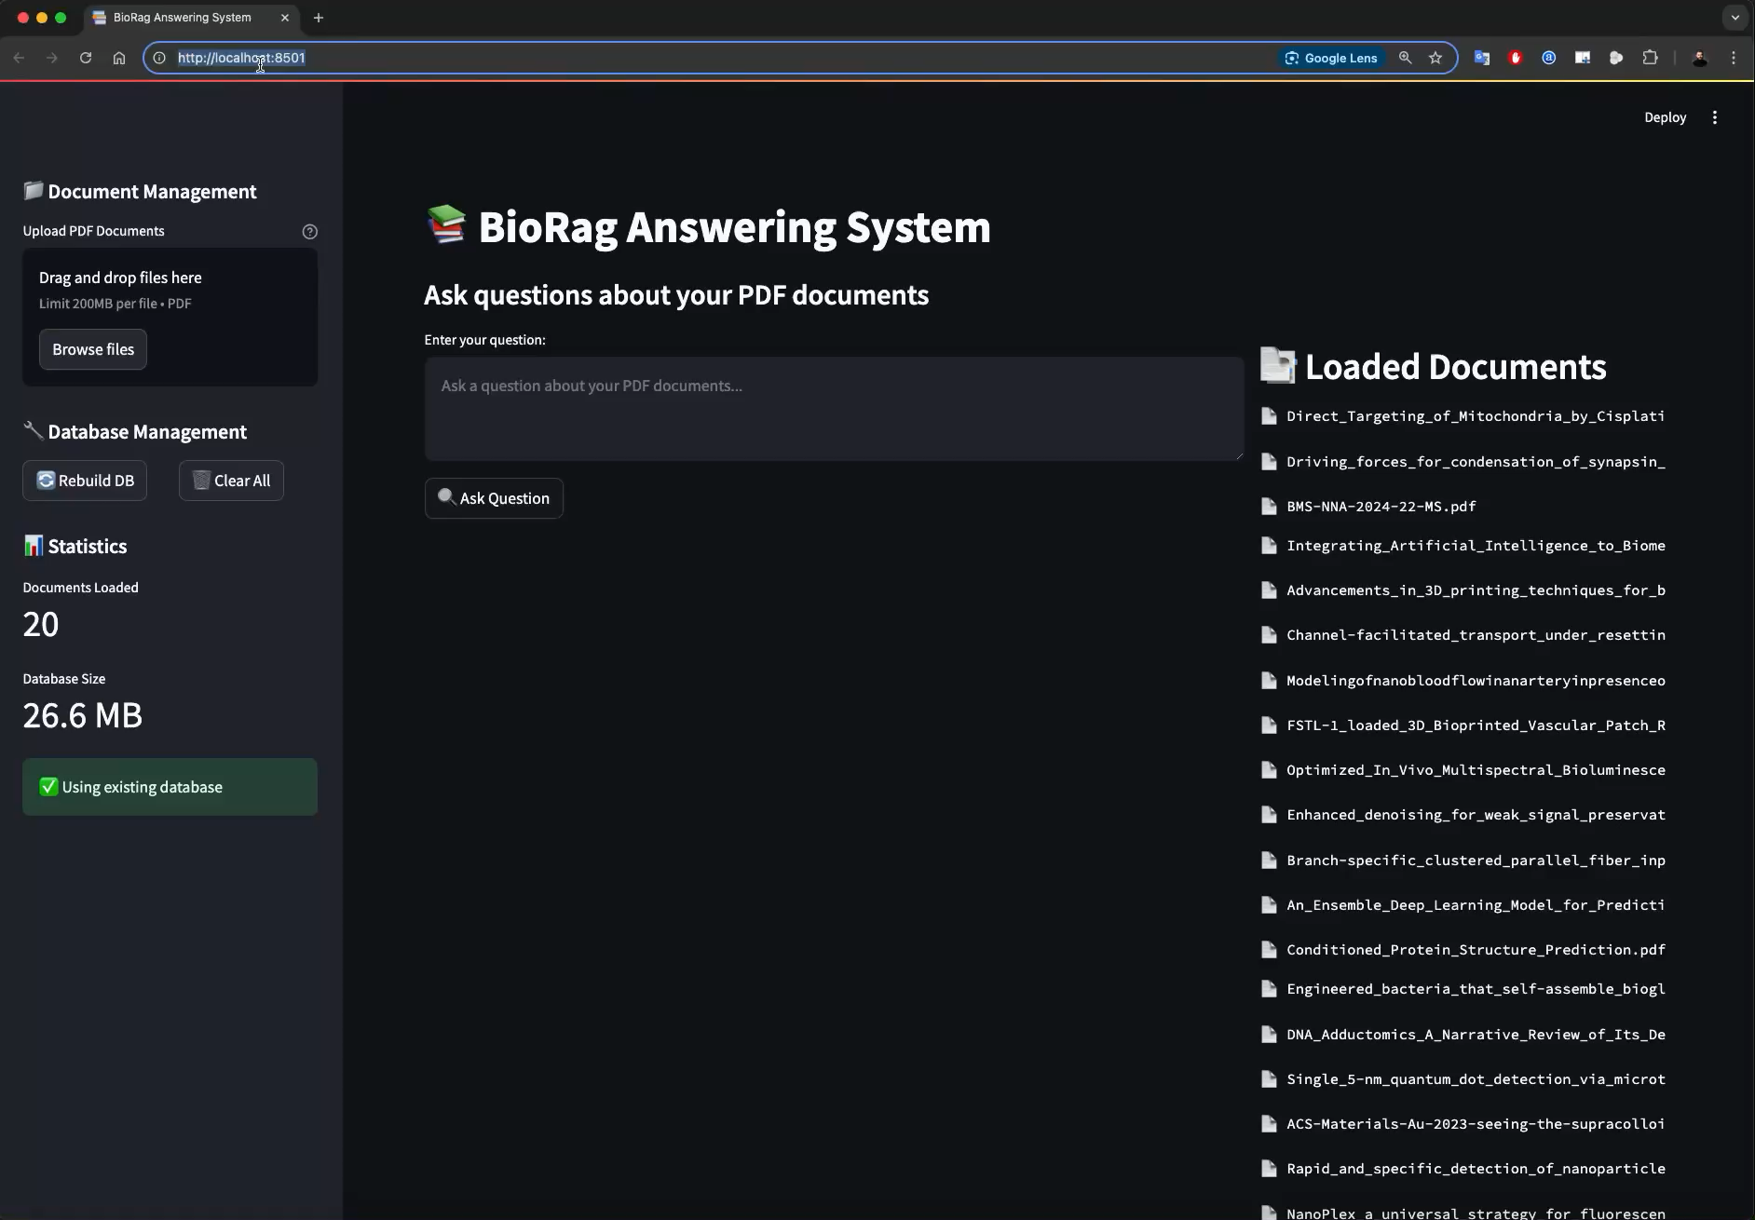

Slide 11
Bio G: Own the RAG
https://senlerk-pdf-rag-ui-h0kpio.streamlit.app/
Here you can upload your own PDF files and ask questions based on the retrieved information from the PDFs!
Short info: This webpage doesn‘t run with ChromaDB and uses LangChain.

Slide 12
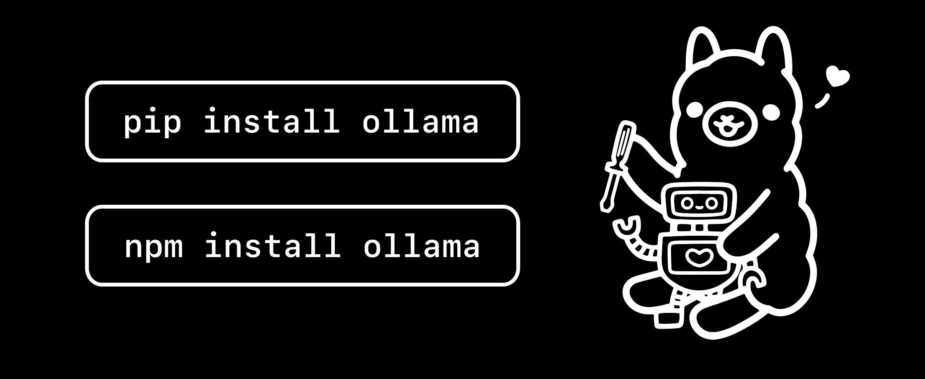
Bio G: Challenges & Solutions
Connecting to Ollama
Importing the necessary packages that were partially not compatible
Streamlit Error: Loading the dataset → Deleting the dataset and newly importing

Slide 13
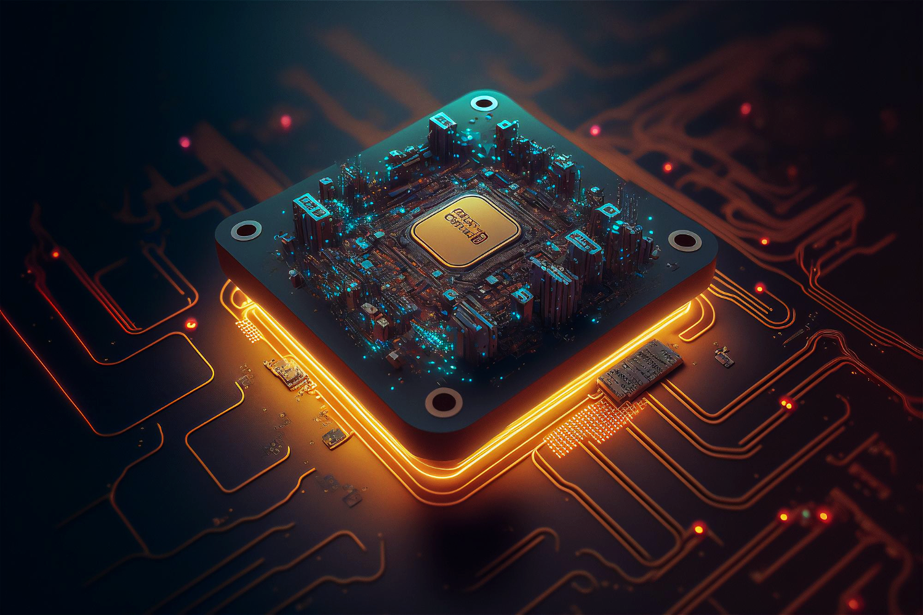
Bio G: Tools & Technologies
Working online & offline
Visual Studio Code
ChatGPT
Claude
Ollama
LangChain
Streamlit

Slide 14
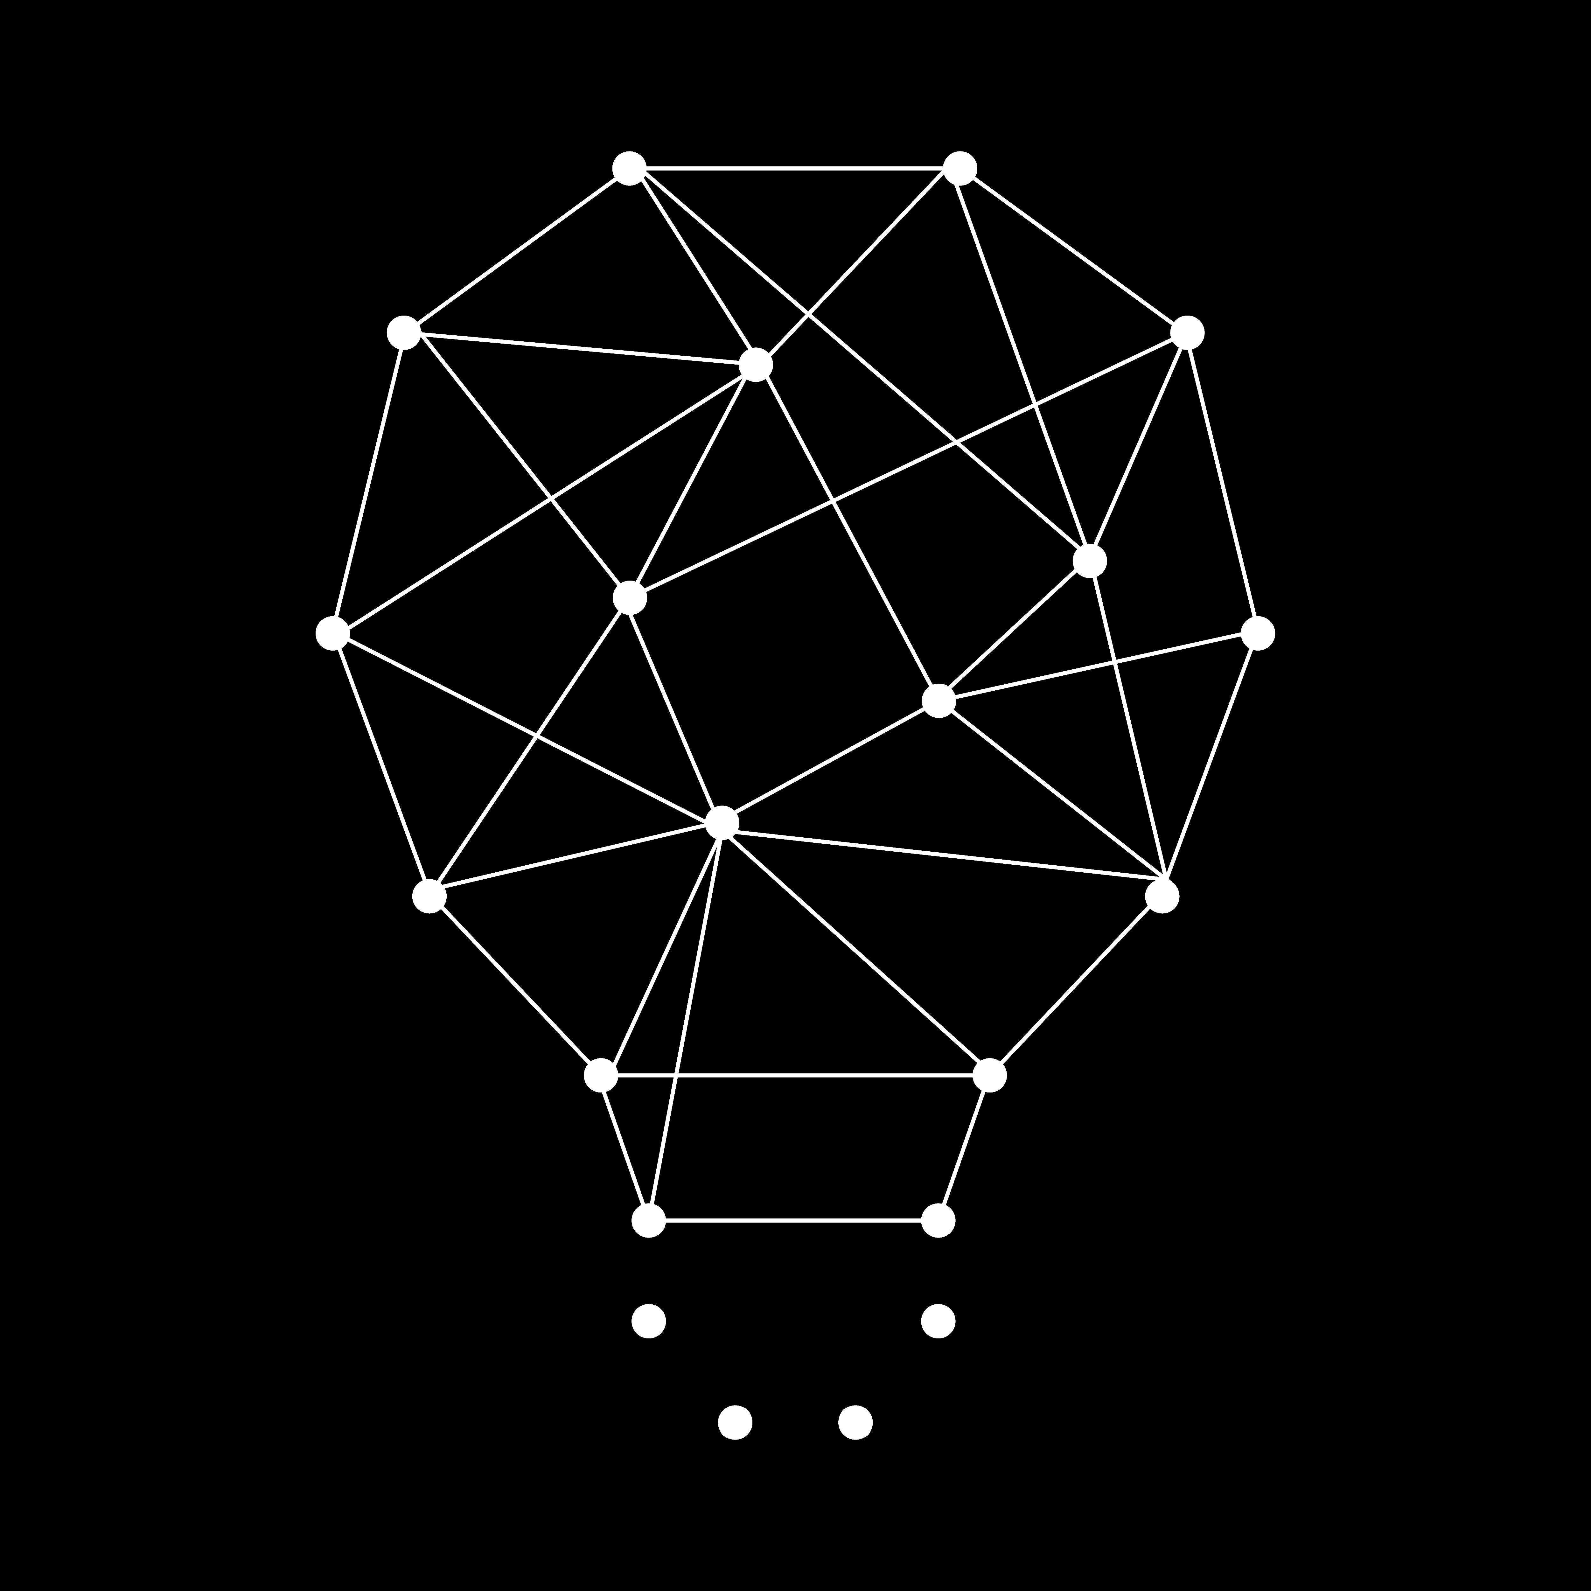
Bio G: Conclusion & Insights
Images and numbers are hard to interpret (we tried but it wasn‘t very good → maybe some models could be included with LangChain, e.g. computer vision models → we didn‘t find any pre-trained ones for our task)

Slide 15
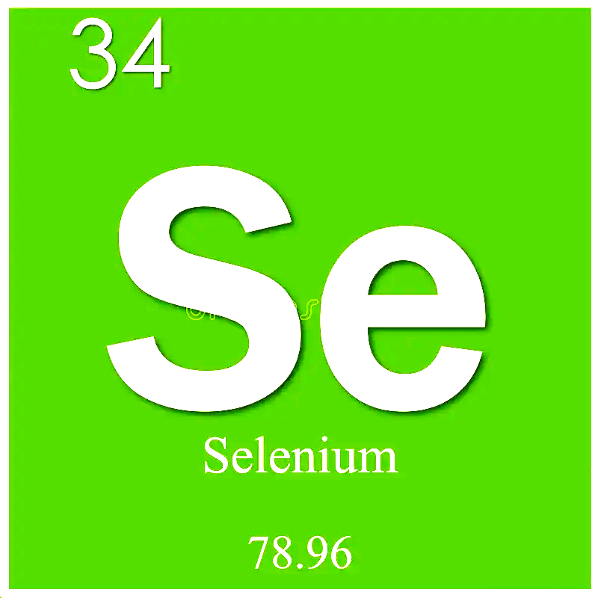
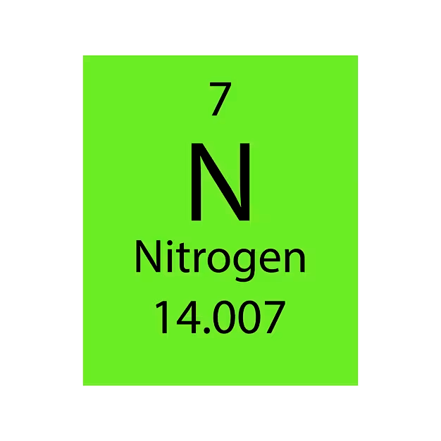
Bio G
Thank you for listening!
By Kerem nler & Julia uss

